Slide 1


VISVESVARAYA TECHNOLOGICAL UNIVERSITY
“Jnana Sangama”, Belagavi-590018
“Conversion to smart homes ”
AMITH BHAT 4SF19EC013
KARTHIK R 4SF19EC041
RAHUL BHAT 4SF19EC039
DEEPAK P SHETTY 4SF19EC031
Under the guidance of
DR.SANDEEP BHAT
Designation
Department of Electronics & Communication Engineering
Sahyadri College of Engineering & Management
Adyar, Mangaluru-575007

Slide 2
Contents
Introduction
Problem statement
Objectives
Literature Survey
Methodology
Requirement Analysis
Gantt Chart
Expected Outcome
References

Slide 3
Introduction
This project presents an Internet of Things (IoT) Voice Controlled Home Automation System.
This project is useful to control almost all the home \ office IOT devices .
It is also designed in such a way that simple household activities such as turning on/off light, fan etc.
This project helps the elderly and physically disabled people to turn on and off the devices that might be hard to reach.

Slide 4
Problem Statement
The manual way of controlling appliances in houses / office premises is difficult at times and also during emergencies , the ability to use them with voice commands makes it simple .

Slide 5
Objectives
To use voice commands to execute day to day activities.
Cheaper way of home automation.
Use voice commands to assist physically challenged and elderly people with limited mobility.
To increase privacy where necessary by not needing to connect to internet.

Slide 6
Literature Survey
[1]The Internet of things can be defined as connecting the various types of objects like smart phones, personal computer and Tablets to internet, which brings in very new type of communication between things and people and also between things.
[2]Arduino is an open source programmable board. It is very easy to use and powerful single board computer that has gained considerable traction in the hobby and professional market
[3] The MIT App Inventor user interface includes two main editors: the design editor and the blocks editor. The design editor, or designer , is a drag and drop interface to lay out the elements of the application’s user interface (UI). In this way, anyone can quickly build a mobile app and immediately begin to iterate and test.

Slide 7
Literature Survey
[4]Due to limitless opportunities in IoT technology, security and privacy becomes two key concerns. Most of the privacy threats disclosing the private information to unwanted parties
[5]Smart homes also provides increased energy efficiency.

Slide 8
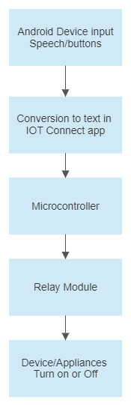
Methodology

Slide 9
Methodology
The mobile receives the voice input .
The IoT connect app converts the speech to text.
IoT connect app also has buttons to control devices
The signal from IoT connect app is sent over Bluetooth to microcontroller.
The microcontroller takes the data and compares it to the predefined library to give output.
The devices are turned on and off according to the output of microcontroller.

Slide 10
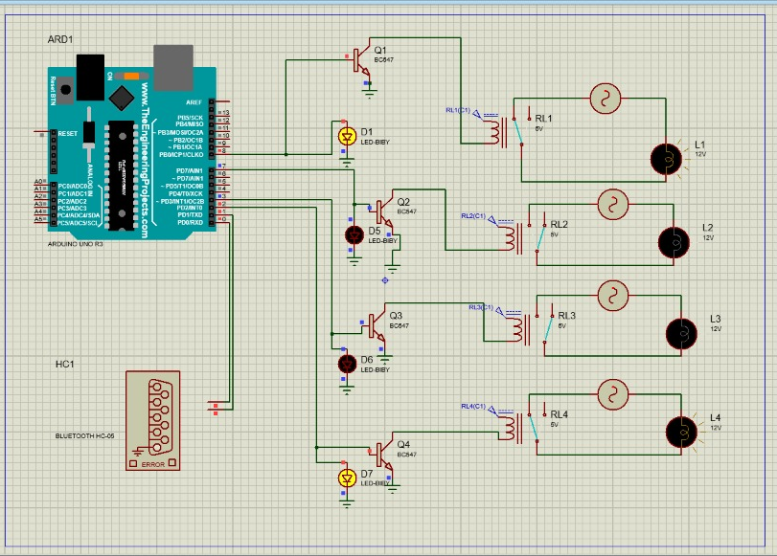
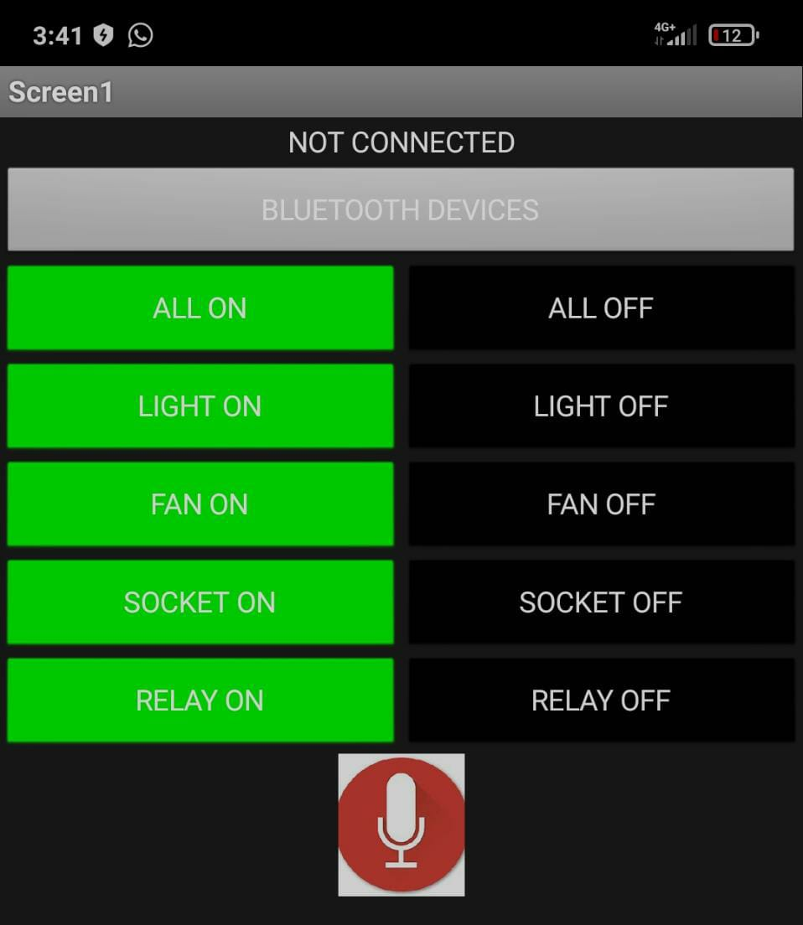
DESIGN
Schematic representation
UI of IoT connect app

Slide 11
Requirement Analysis
1 Software Specifications
Arduino Integrated Development Environment (IDE).
MIT App Inventor.
4.2 Hardware Specifications
Arduino UNO.
Android device.
Relay.
Bluetooth module.
Existing home appliances.

Slide 12
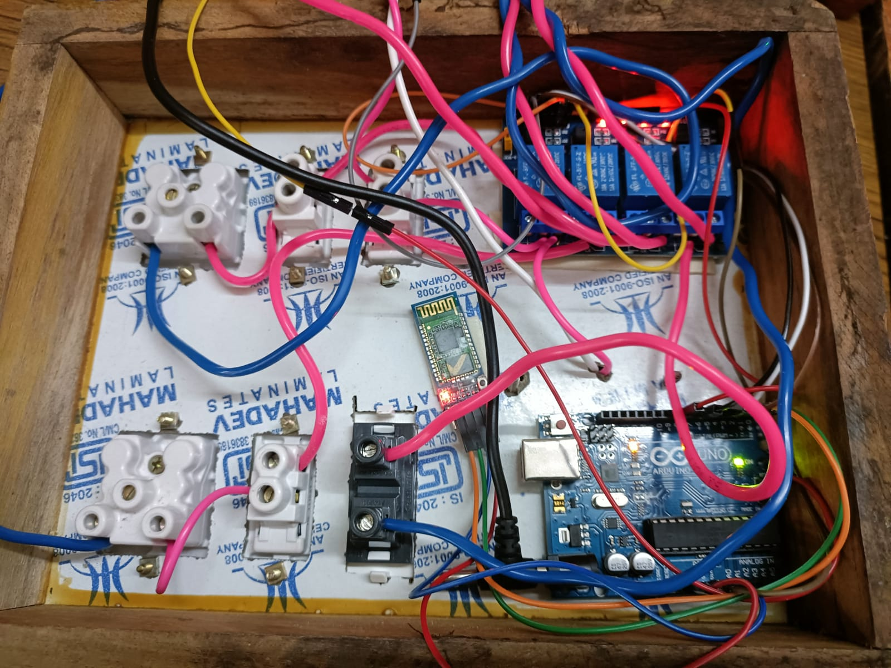
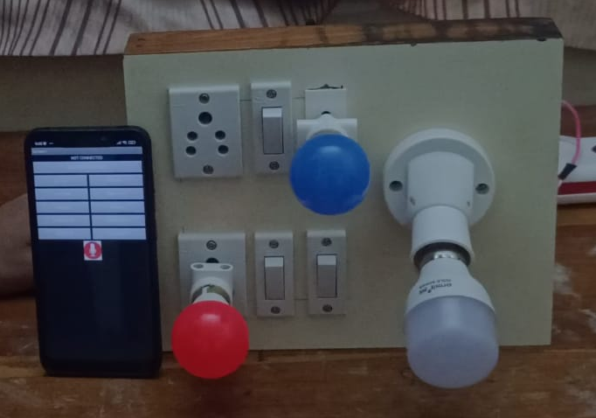
Prototype

Slide 13
Conclusion and Future scope
Conclusion: voice controlled home automation system with an android app with which we can control almost all the electric appliances in our house, office and in other premises. Using the right voice commands the user can operate any electrical device connected to system without moving.
Future scope: Number of different sensors can be implemented to the circuit to perform more versatile operations. Can also used as security device to alert in any situations

Slide 14
References
[1]A Review Paper on Home Automation System Based on Internet of Things Technology Swati Tiwari , Rahul Gedam , 05-May-2016
[2]Role Of Arduino In Real World Applications by Kuldeep Singh Kaswan, Santar Pal Singh, Shrddha Sagar, 01, JANUARY 2020
[3]MIT App Inventor: Objectives, Design, and Development by Even W. patton, Michael Tissenbaum & Farzeen Harunani , 03- may-2019
[4]A Study on Privacy Issues in Internet of Things (IoT) published by IEEE , 10 January 2021
[5]Applications, systems and methods in smart home technology by rosslin john robles and tai-hoon kim 1

